Slide 1
Regression Techniques
Content Library

Slide 2
Linear Regression
Pre-Processing
Training Documents
Testing Documents
Udemy - Deep Learning Prerequisites: Linear Regression
1. Introduction to Least Squares
MCQ on least squares and regression concepts
ISLR Chapter 3 : Linear Regression
2. Linear Regression using sk-learn
Practical MCQ on each tutorial
https://medium.freecodecamp.org/data-science-with-python-8-ways-to-do-linear-regression-and-measure-their-speed-b5577d75f8b
3. Train/test split
Practical Jupyter Notebook Test
(Auto graded Marking)
4. Multiple linear regression
http://seismo.berkeley.edu/~kirchner/eps_120/Toolkits/Toolkit_10.pdf
5. Variable selection
6. Comparing models

Slide 3
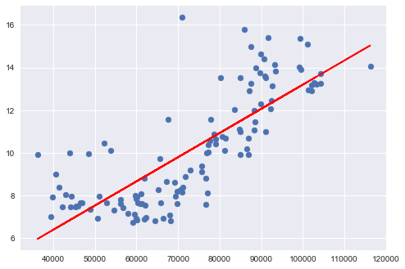
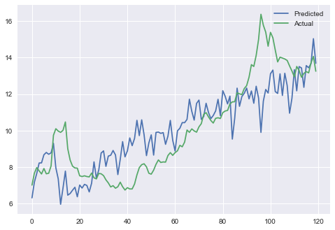
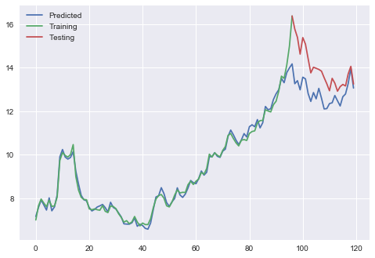
1. Linear Regression
1. Introduction to Least Squares
2. Linear regression with scikit-learn
3. Train/test split
4. Multiple linear regression
5. Variable selection

Slide 4
Regularization
Pre-Processing
Training Documents
Testing Documents
ISLR Chapter 6 : Regularization
1. Ridge regression
MCQ on regularization concepts
2. The LASSO
Cross validation practical MCQ
3. Cross Validation, hyperparameter tuning
4. Comparing models

Slide 5
Tree-based Methods for Regression
Pre-Processing
Training Documents
Testing Documents
https://www.youtube.com/watch?v=LDRbO9a6XPU
0. Build a Decision Tree From Scratch
MCQ on Theory (gini, information gain)
1. Decision Trees using sk-learn
MCQ on Parameter Tuning
2. Hyperparameter Tuning
MCQ on Ensemble Methods
3. Multiple Variable Tree
4. Random Forests (2 parts)
5. Boosting
6. Comparing models

